Slide 1


Modern Architecture Instrumentation
Paulo Monteiro - #datanerd
©2008–18 New Relic, Inc. All rights reserved

Slide 2
Safe Harbor
This presentation and the information herein (including any information that may be incorporated by reference) is provided for informational purposes only and should not be construed as an offer, commitment, promise or obligation on behalf of New Relic, Inc. (“New Relic”) to sell securities or deliver any product, material, code, functionality, or other feature. Any information provided hereby is proprietary to New Relic and may not be replicated or disclosed without New Relic’s express written permission.
Such information may contain forward-looking statements within the meaning of federal securities laws. Any statement that is not a historical fact or refers to expectations, projections, future plans, objectives, estimates, goals, or other characterizations of future events is a forward-looking statement. These forward-looking statements can often be identified as such because the context of the statement will include words such as “believes,” “anticipates,” “expects” or words of similar import.
Actual results may differ materially from those expressed in these forward-looking statements, which speak only as of the date hereof, and are subject to change at any time without notice. Existing and prospective investors, customers and other third parties transacting business with New Relic are cautioned not to place undue reliance on this forward-looking information. The achievement or success of the matters covered by such forward-looking statements are based on New Relic’s current assumptions, expectations, and beliefs and are subject to substantial risks, uncertainties, assumptions, and changes in circumstances that may cause the actual results, performance, or achievements to differ materially from those expressed or implied in any forward-looking statement. Further information on factors that could affect such forward-looking statements is included in the filings New Relic makes with the SEC from time to time. Copies of these documents may be obtained by visiting New Relic’s Investor Relations website at ir.newrelic.com or the SEC’s website at www.sec.gov.
New Relic assumes no obligation and does not intend to update these forward-looking statements, except as required by law. New Relic makes no warranties, expressed or implied, in this presentation or otherwise, with respect to the information provided.

Slide 3
Agenda
 | Introduction
 | The Geek’s Movie Shop
 | Tools of Trade
 | Instrumentation
 | Kubernetes
 | Leveraging New Relic

Slide 4




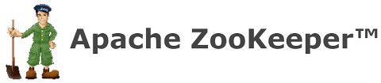






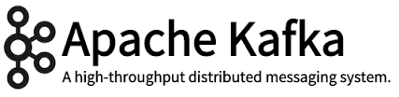



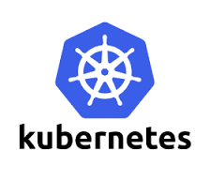
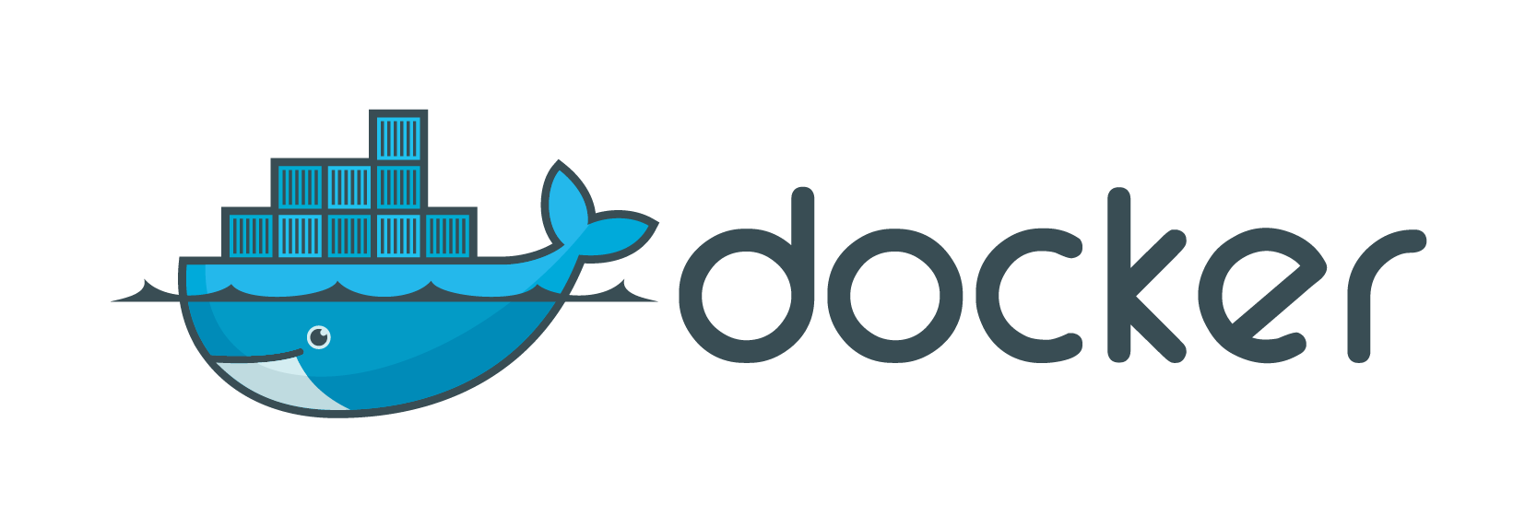







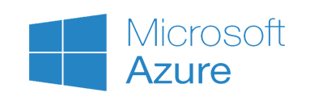




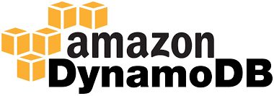

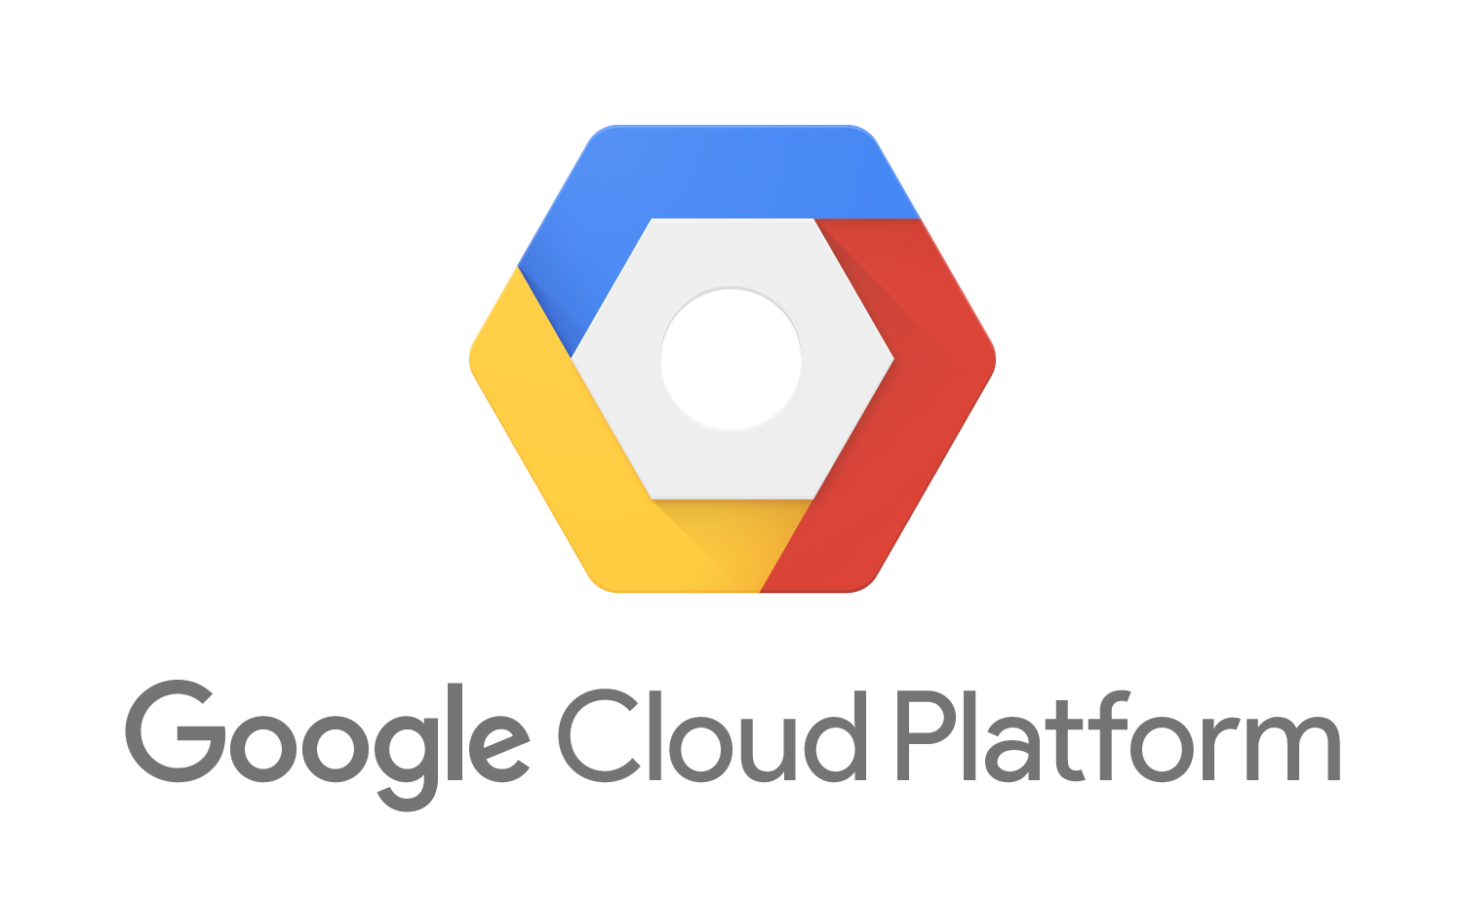
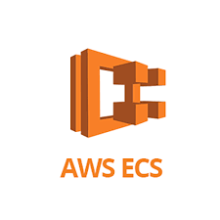





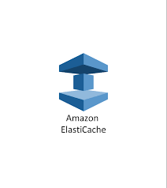



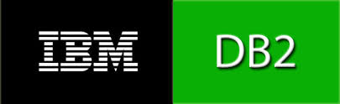


















Distributed Systems Today
Containers / Virtualization
Queues
Infrastructure Applications
Hosts
SaaS Services
Enterprise relational databases
Modern databases & storage

Slide 5
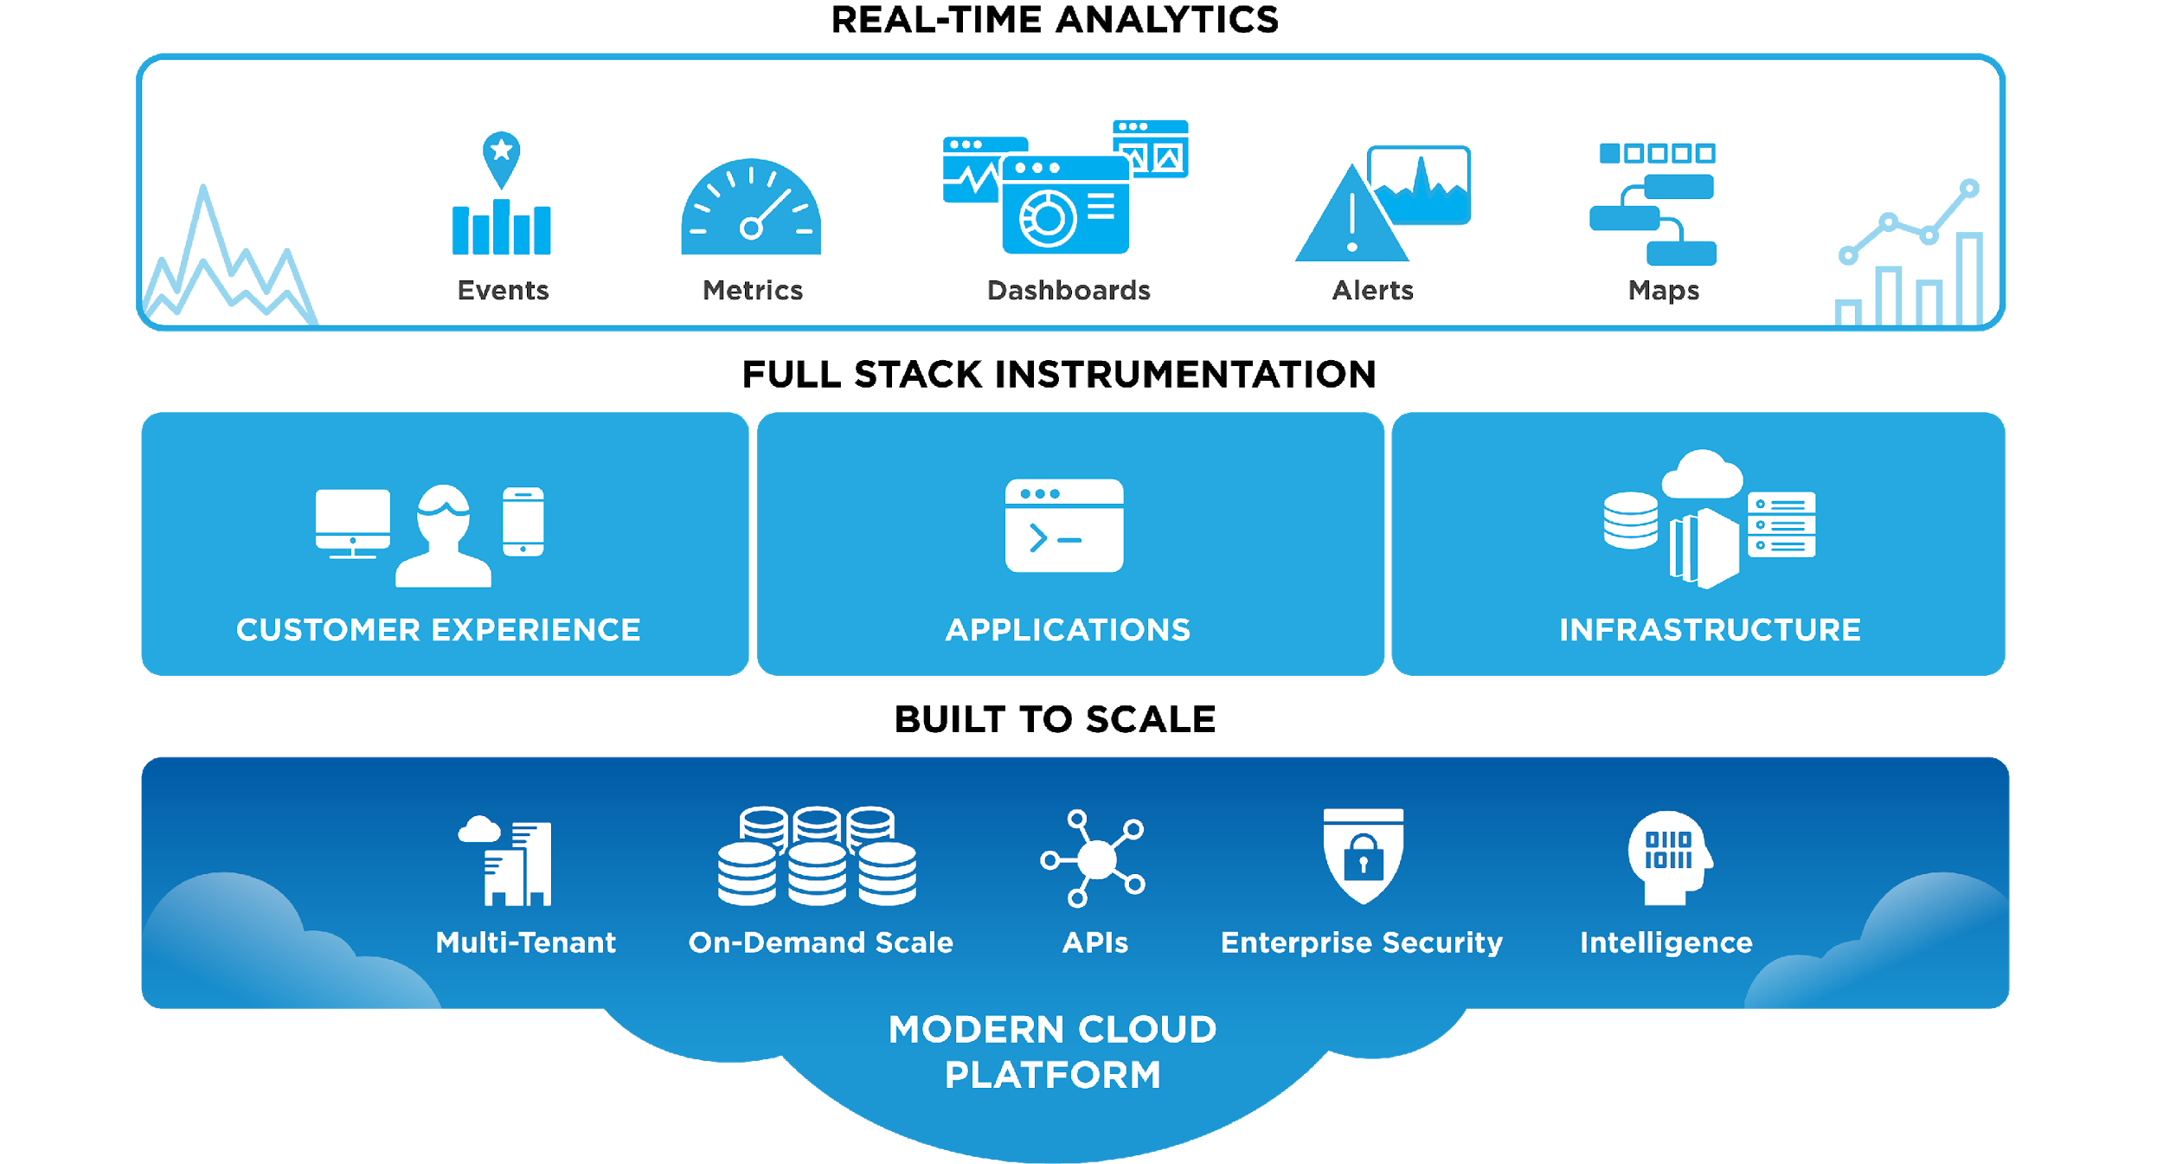
New Relic Platform

Slide 6
Agenda
 | Introduction
 | The Geek’s Movie Shop
 | Tools of Trade
 | Instrumentation
 | Kubernetes
 | Leveraging New Relic

Slide 7
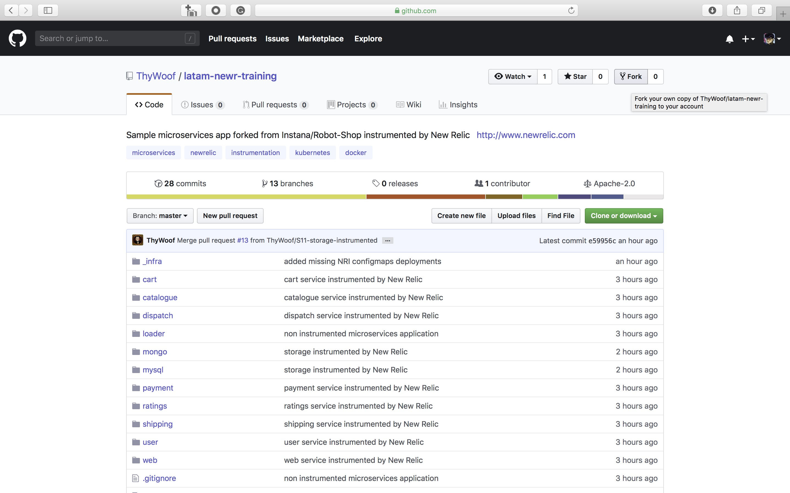
Fork https://github.com/ThyWoof/latam-newr-training

Slide 8


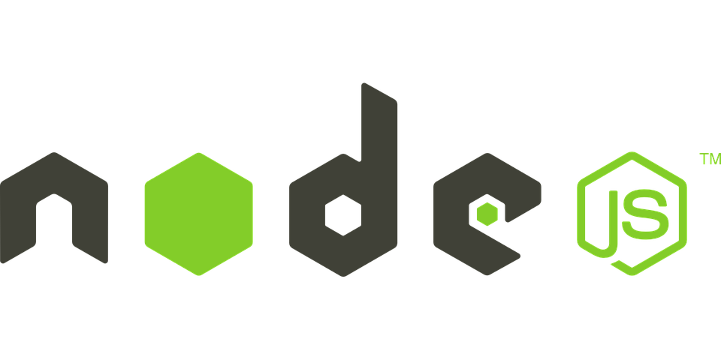

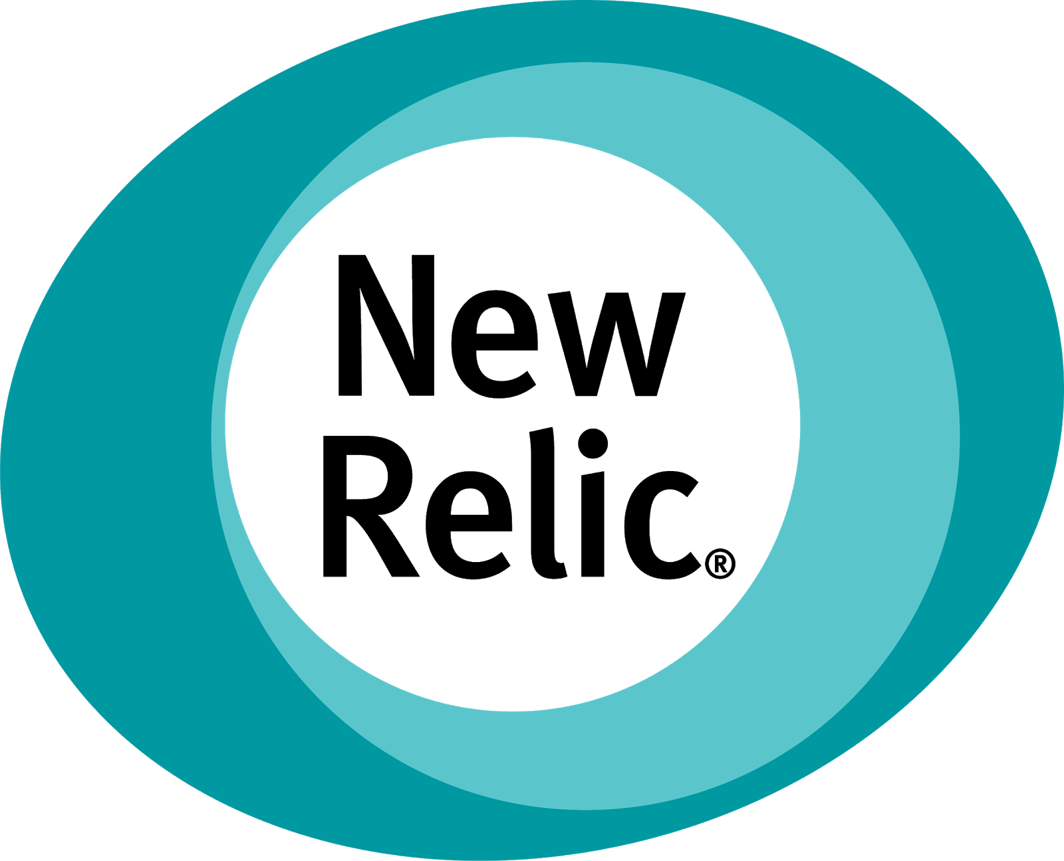

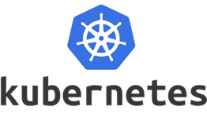

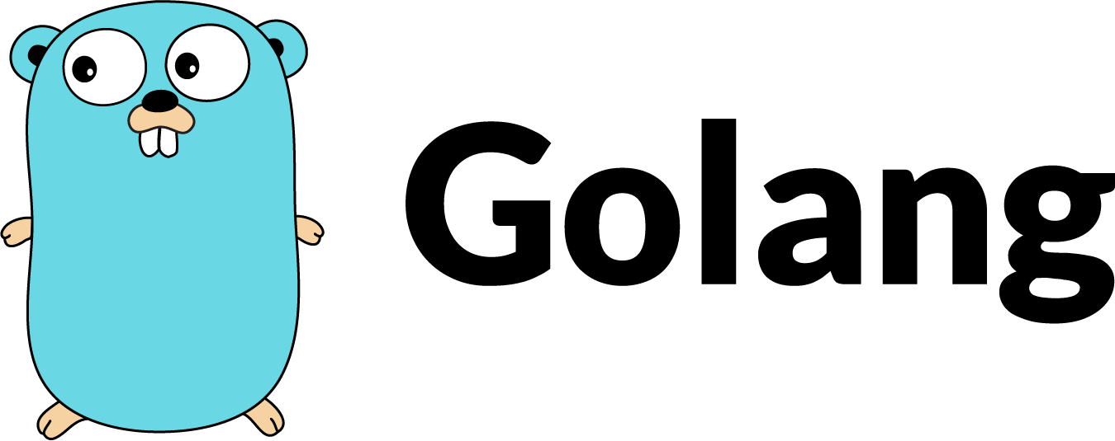

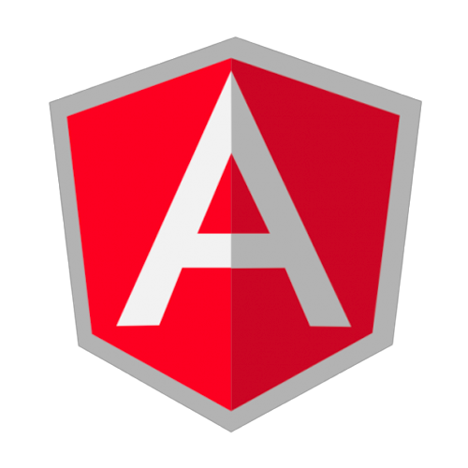

Geek’s Movie Shop Architecture
ratings
catalogue
cart
user
shipping
payment
- catalogue
- cart
- user
- shipping
- ratings
- payment
dispatch
web

Slide 9
Agenda
 | Introduction
 | The Geek’s Movie Shop
 | Tools of Trade
 | Instrumentation
 | Kubernetes
 | Leveraging New Relic

Slide 10
Setup an EC2 Instance

Slide 11
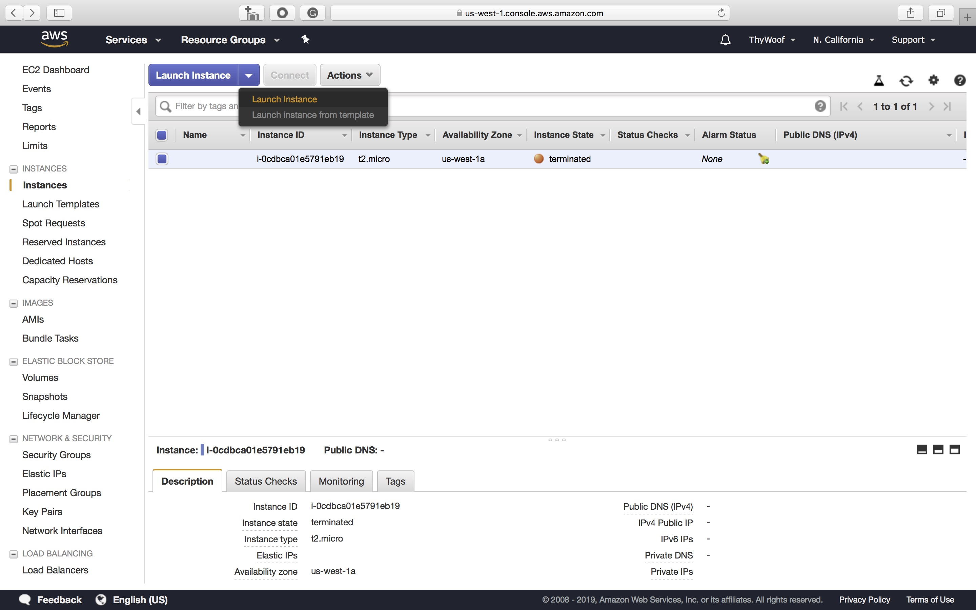
Launch an EC2 Instance

Slide 12
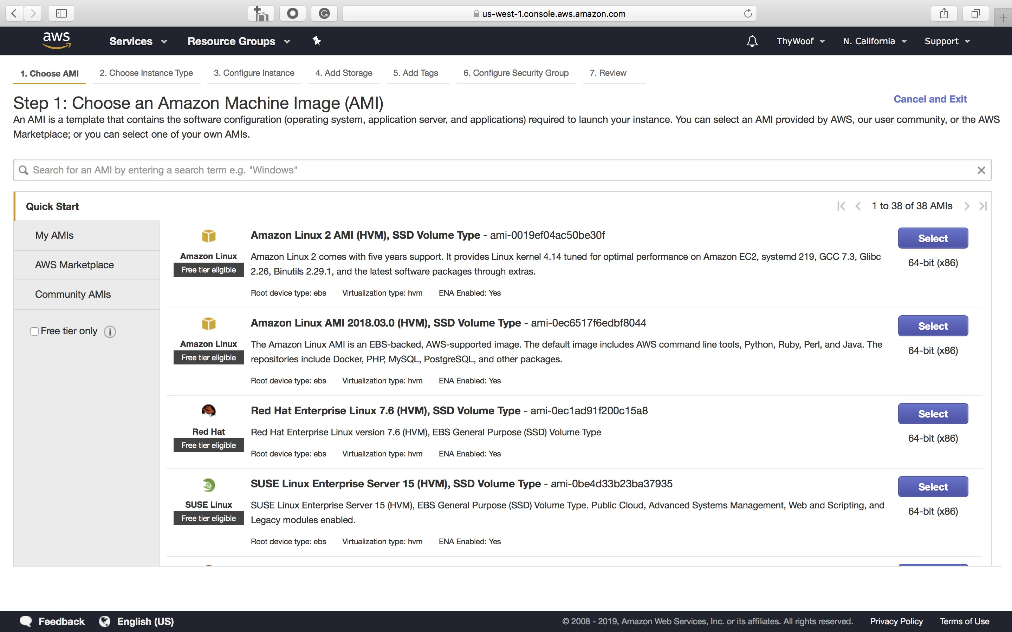
Launch EC2 - Select Amazon Linux AMI

Slide 13
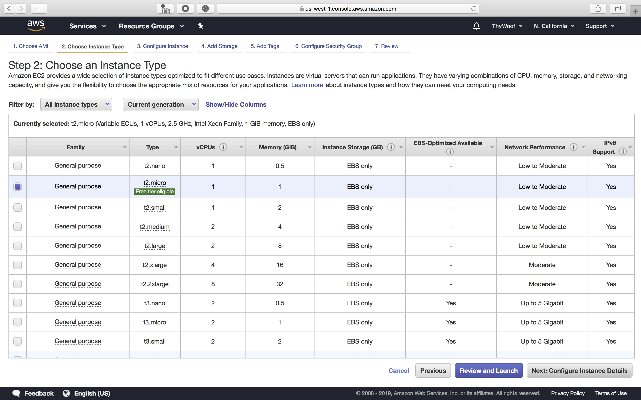
Launch EC2 - Select a t2.nano

Slide 14
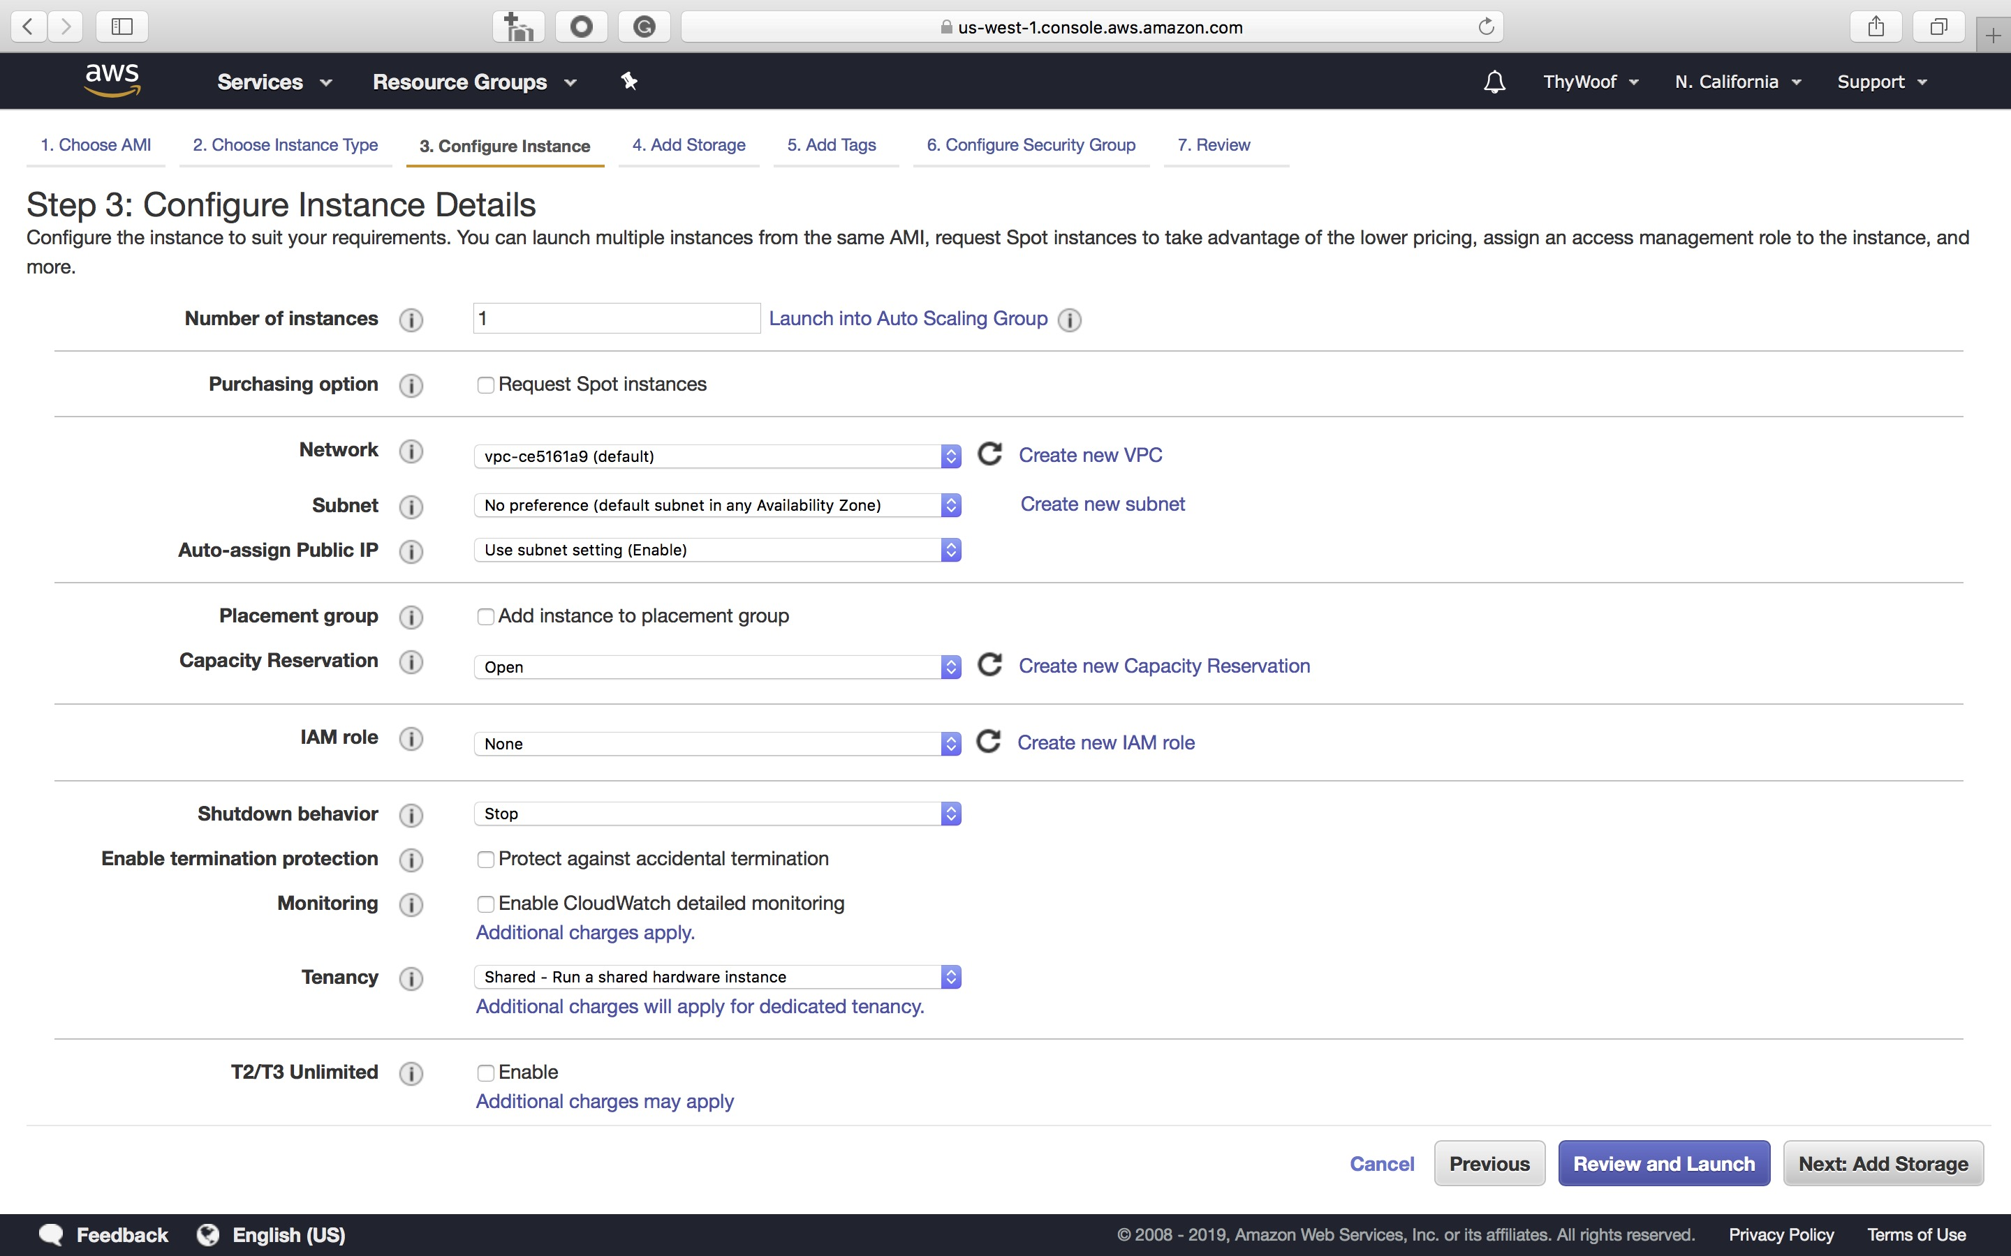
Launch EC2 – Keep default instance details

Slide 15
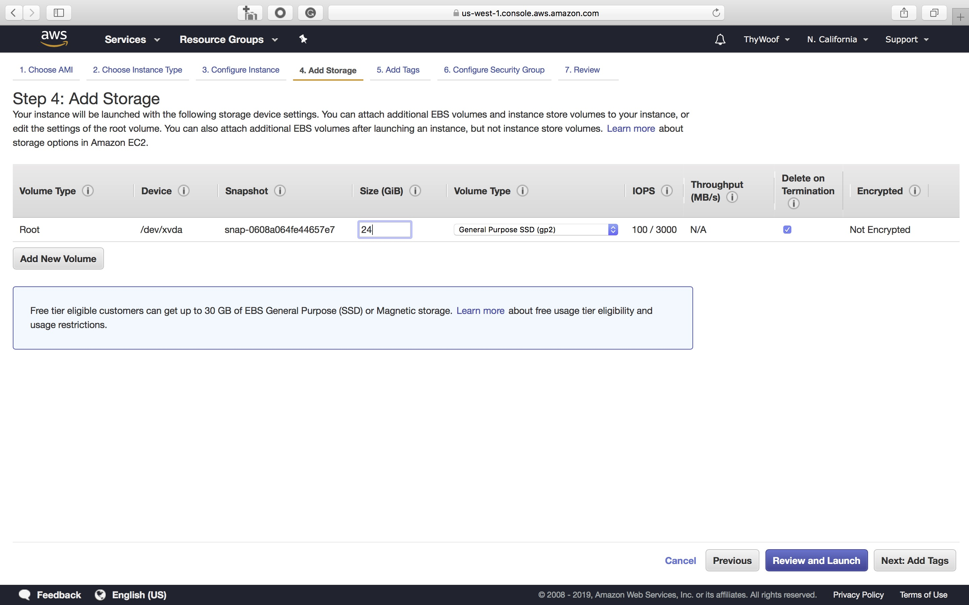
Launch EC2 – Change storage to 24 GiB

Slide 16
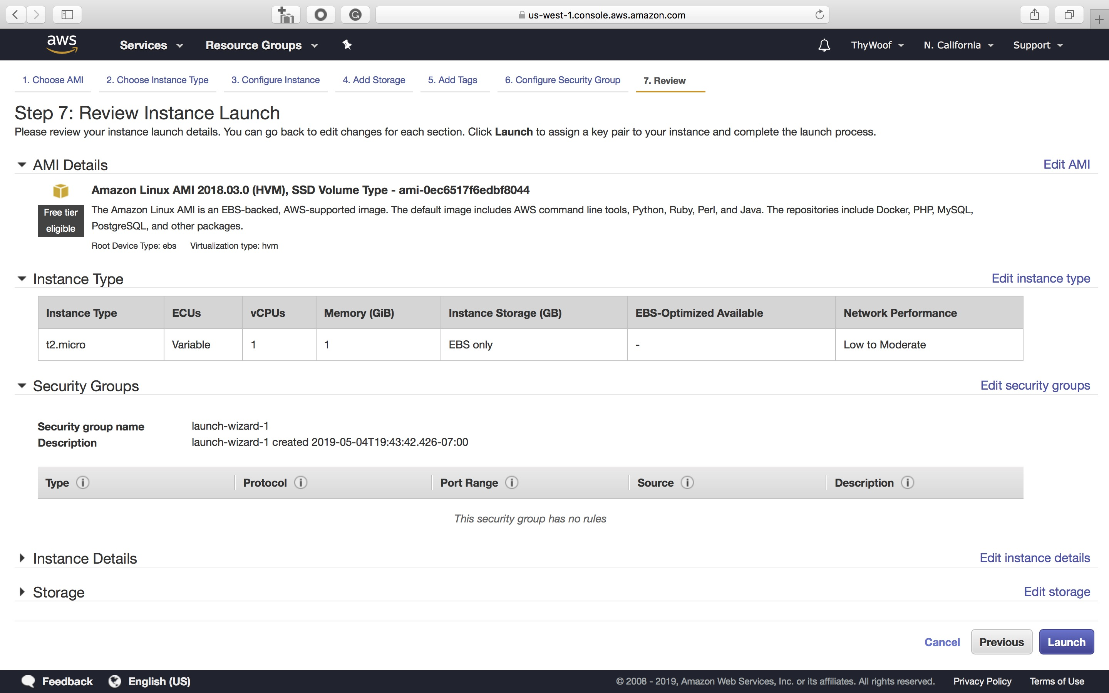
Launch EC2 – Review and launch

Slide 17
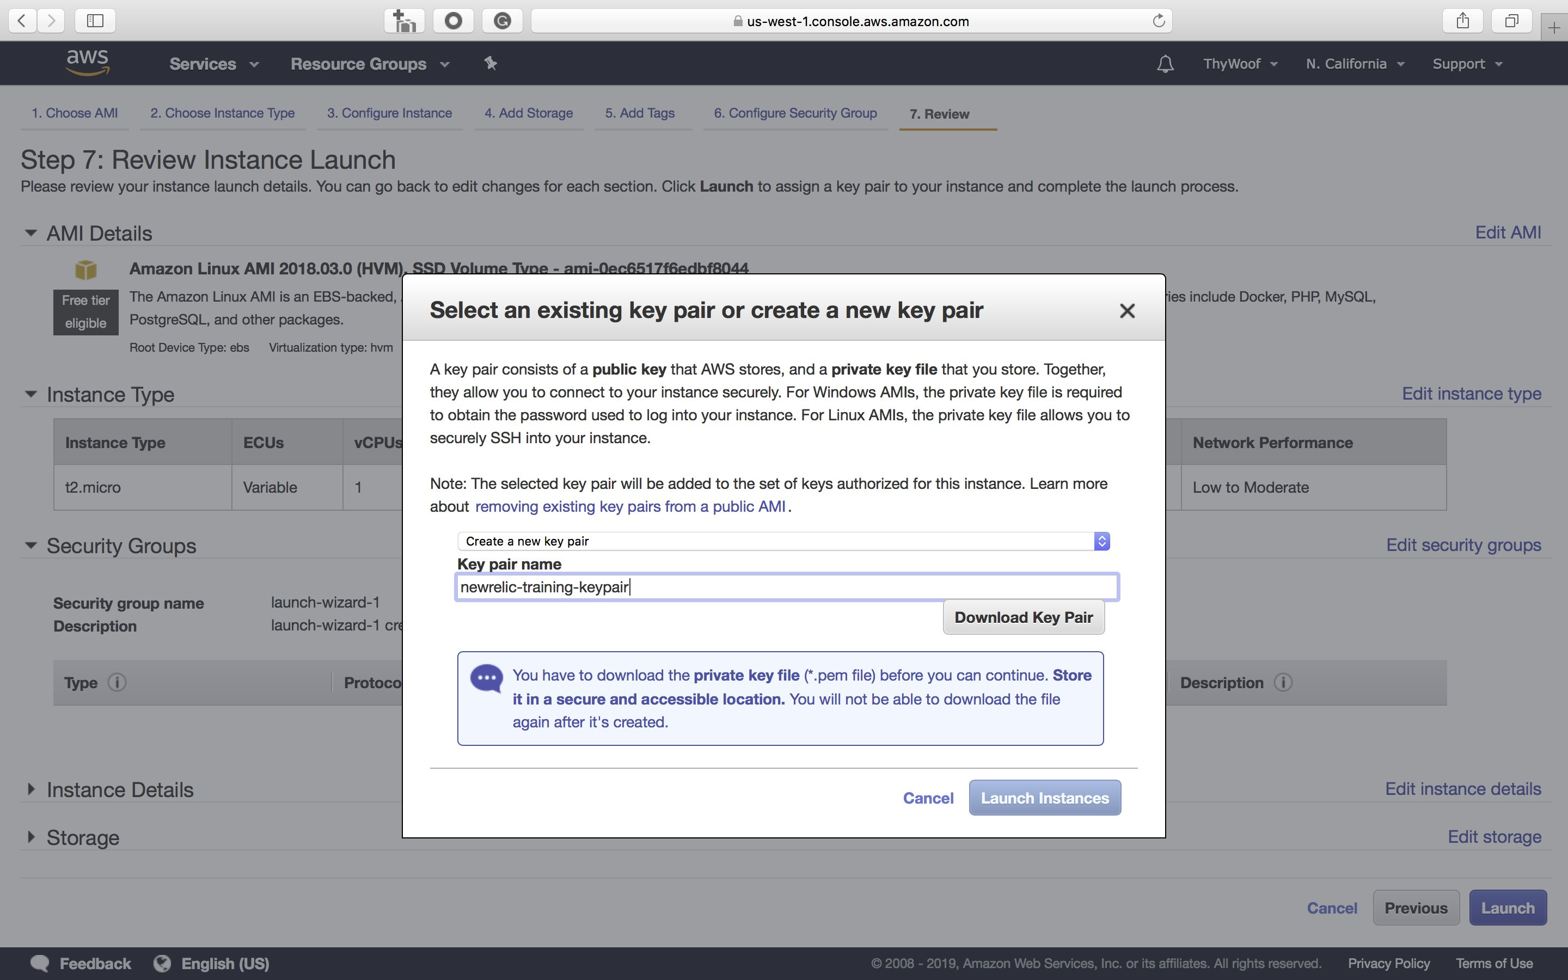
Launch EC2 – Create and download keypair

Slide 18
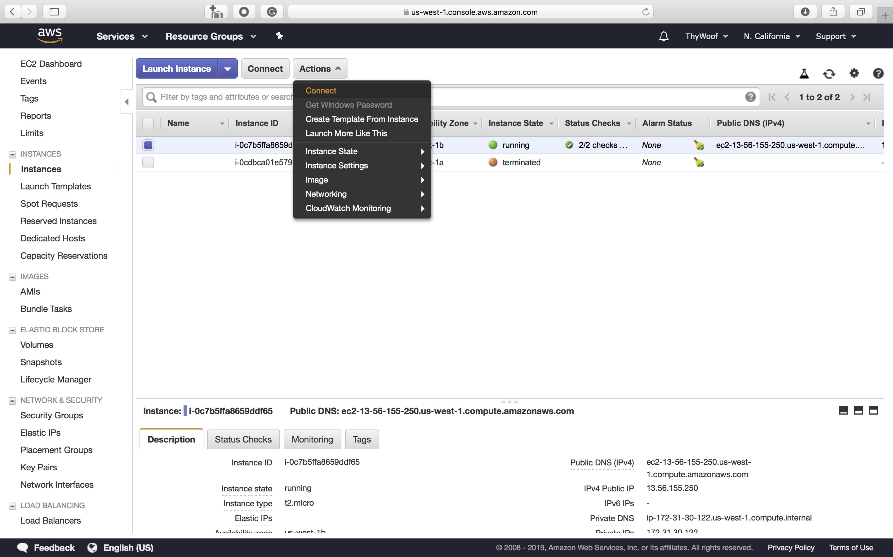
Launch EC2 - Connect

Slide 19
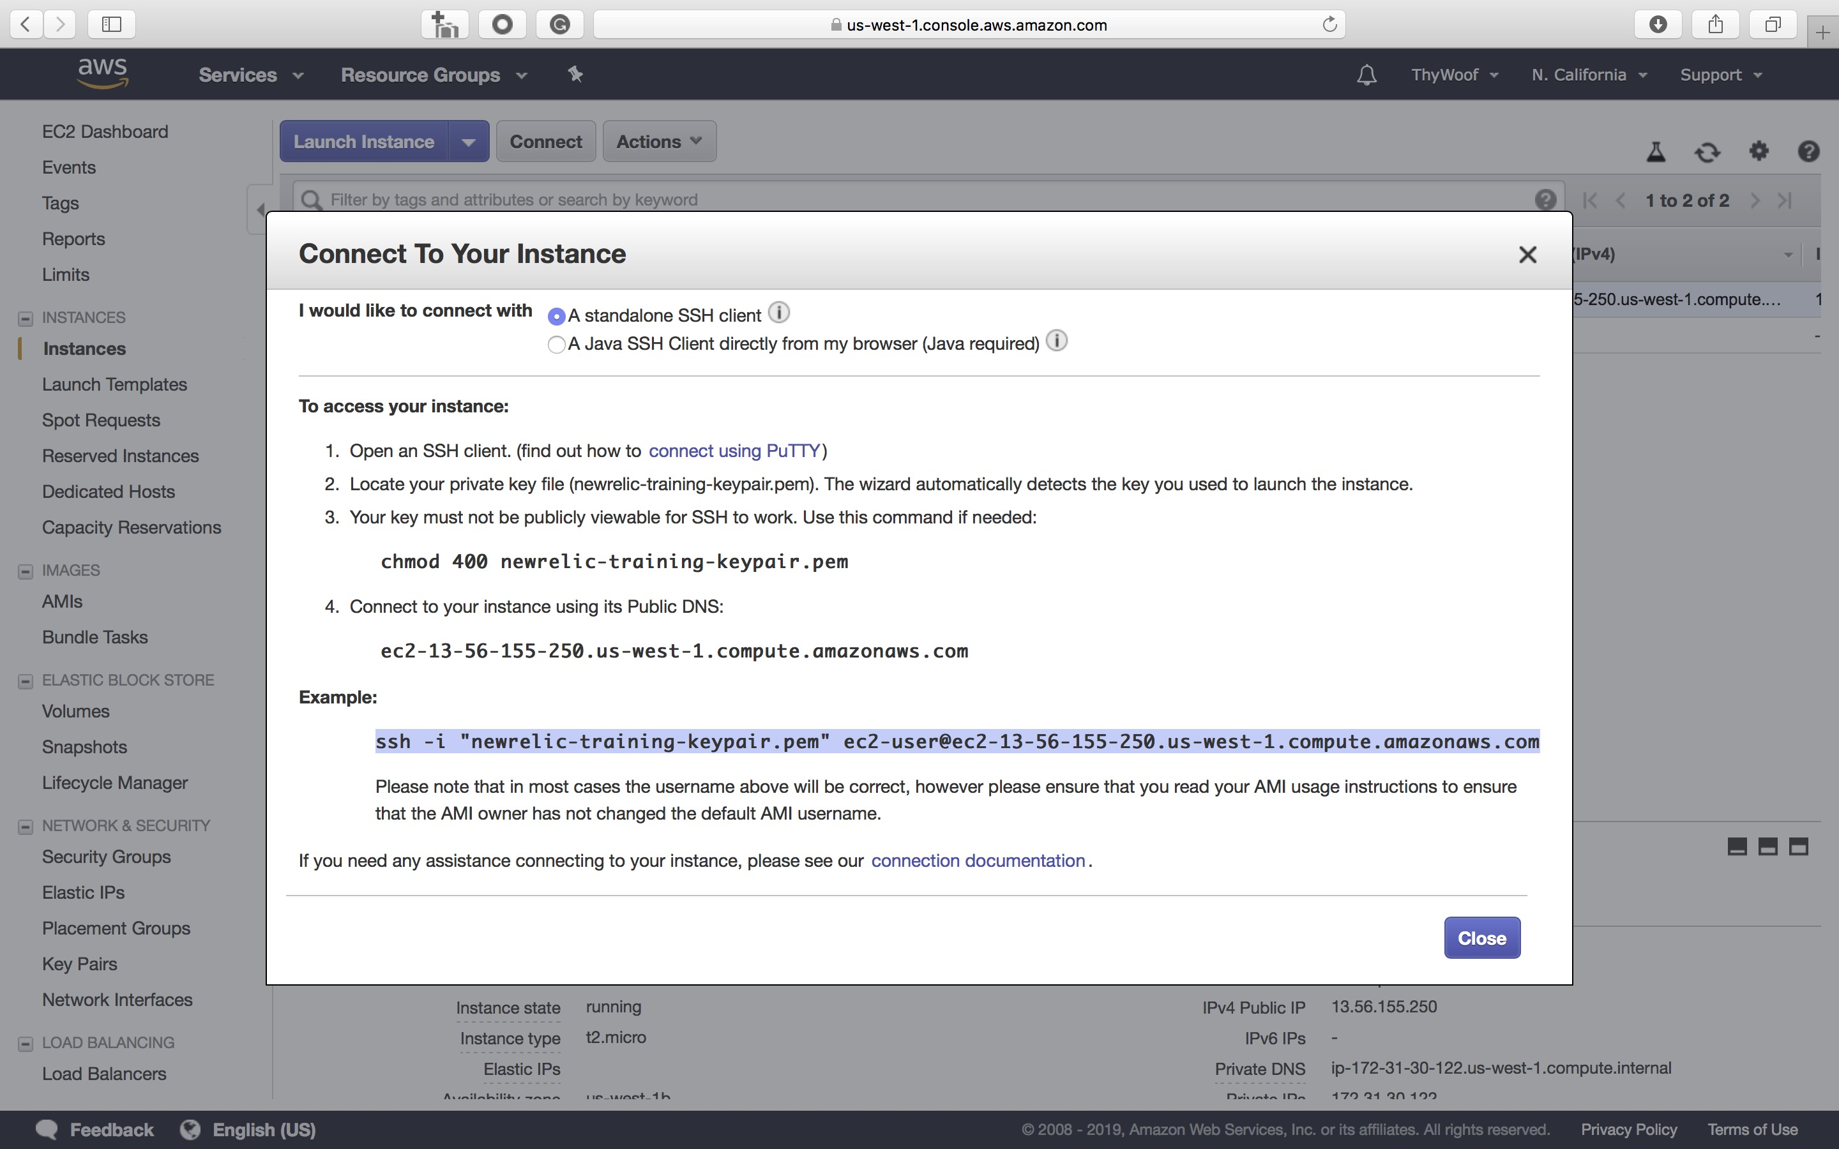
Launch EC2 – Copy and paste ssh command

Slide 20
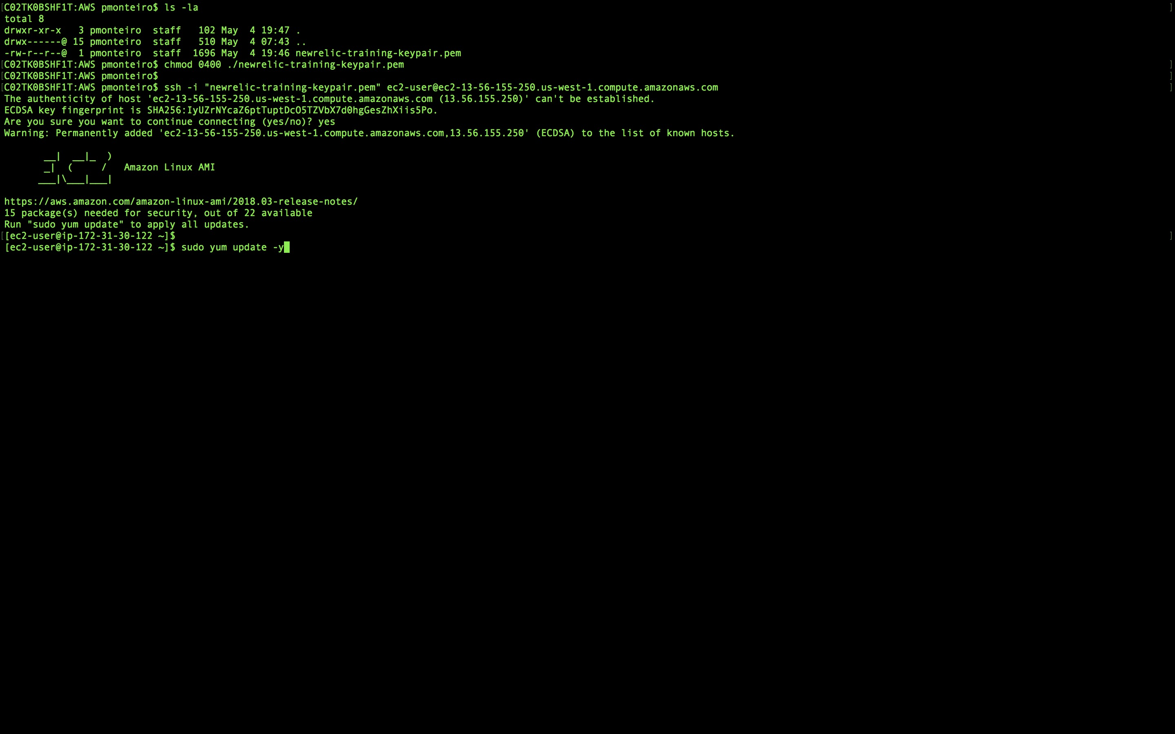
Launch EC2 – Change PEM permissions and run ssh

Slide 21
Configure the instance
Follow training_guide.sh, part 1 on Visual Code

Slide 22

PRODUCT OVERVIEW

Slide 23
Agenda
 | Introduction
 | The Geek’s Movie Shop
 | Tools of Trade
 | Instrumentation
 | Kubernetes
 | Leveraging New Relic

Slide 24
Instrument the Services
Let’s travel in time with Branches

Slide 25

PRODUCT OVERVIEW

Slide 26

PRODUCT OVERVIEW

Slide 27

PRODUCT OVERVIEW

Slide 28
Agenda
 | Introduction
 | The Geek’s Movie Shop
 | Tools of Trade
 | Instrumentation
 | Kubernetes
 | Leveraging New Relic

Slide 29
Basic Kubernetes terminology
Pod
Service
Pod - Basic ephemeral building block
Pod
Container - Standard unit of software that packages software code and all dependencies
Node = Server/VM - Multiple pods on 1 node
Service - Abstraction layer to access pods
Node

Slide 30
Setup Kubernetes
Follow training_guide.sh, part 2 on Visual Code

Slide 31
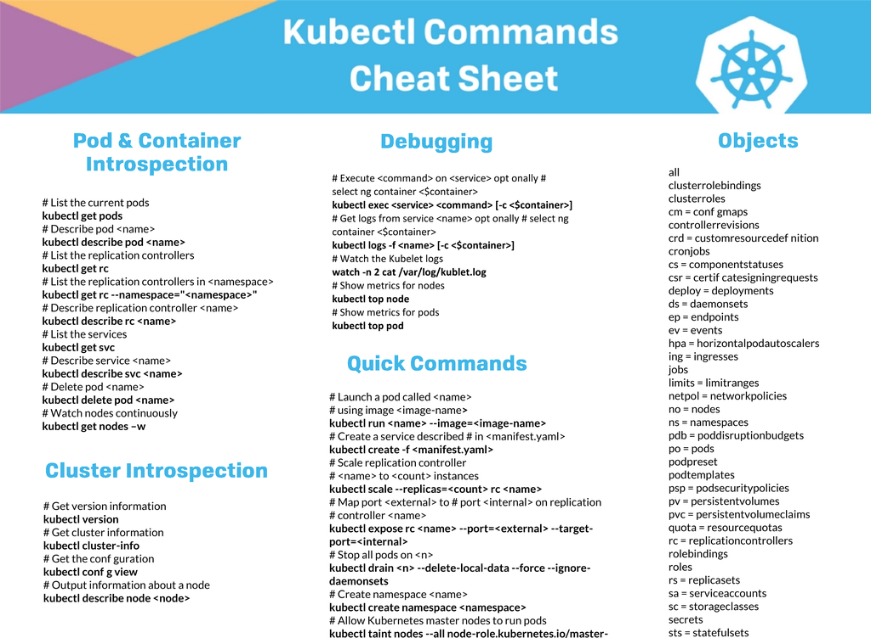
Kubectl Cheat Sheet

Slide 32
Deploy Services to K8

Slide 33
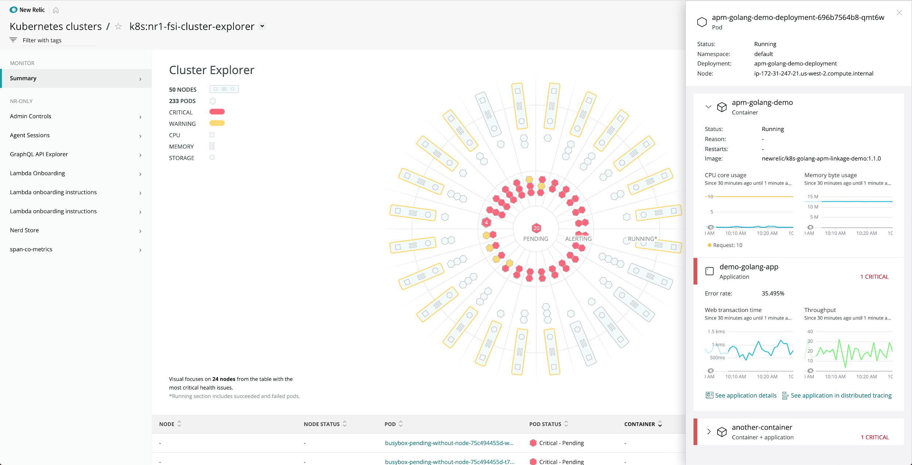
New Relic Kubernetes Cluster Explorer

Slide 34
Agenda
 | Introduction
 | The Geek’s Movie Shop
 | Tools of Trade
 | Instrumentation
 | Kubernetes
 | Leveraging New Relic

Slide 35
Dashboards, Alerts and APIs

Slide 36
Paulo Monteiro
pmonteiro@newrelic.com

